Slide 1
Spark Streaming for Data Engineering
Week-1
In this first of two modules, learn what streaming data is and get the essential knowledge to use Spark for Structured Streaming. Learn about data sources, streaming output modes, and supported data destinations. Learn about data operations considerations and discover how Spark Structured streaming listeners and checkpointing benefit streaming data processing. Discover how graph theory works with streaming data. You’ll gain insights into the advantages that Apache Spark GraphFrames offers and learn what qualities make data suitable for GraphFrames processing. Then, explore ETL and learn how to use Apache Spark for data extraction, transformation, and loading, put your newfound knowledge to practice, and gain practical, real-world skills in the ETL for Machine Learning Pipelines hands-on lab.
Learning Objectives
Define streaming data and describes Spark Structured Streaming, its data sources, streaming output modes, supported data sinks, data operations, listeners and checkpointing.
Define graph theory, describe Apache Spark GraphFrames, and identify data suitable for GraphFrames.
Define ETL (Extract, Transform, Load).
Explain how to create component-oriented data science pipelines by using CLAIMED, Elyra, KubeFlow piplines, MLX, and Kubernetes.
Extract, transform, and load data using Apache Spark.

Slide 2
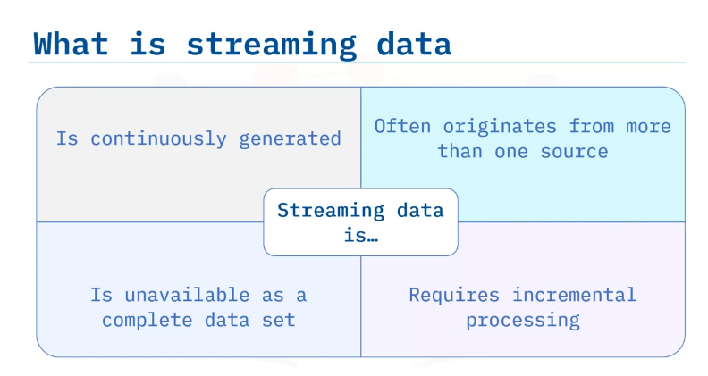
Spark Structured Streaming
define streaming data, describe Structured Streaming,
identify Structured Streaming data sources,
streaming output modes,
and supported data sinks,
describe streaming data operations,
describe streaming listeners and checkpointing.
Streaming data is data that is continuously generated and often originates from more than one source.
Data is unavailable as a complete data set.
Data is continuously created, thus, past data is often unavailable because the data volume is too much to store.
As data is processed, new data arrives, therefore, streaming data requires incremental processing.

Slide 3
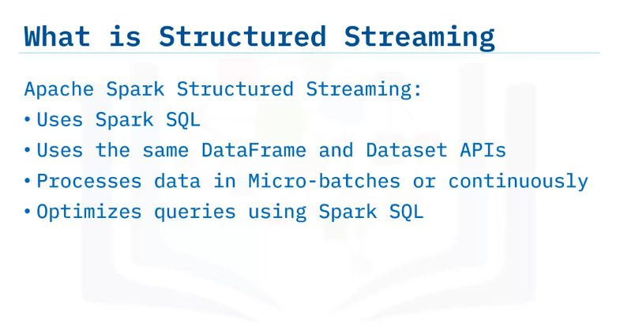
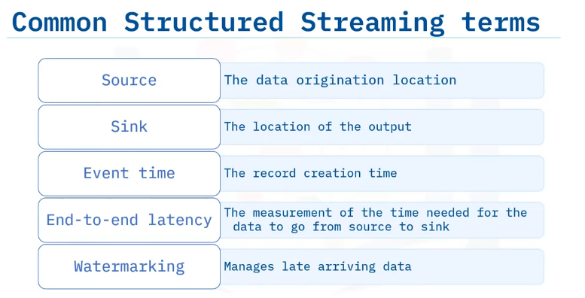
Apache Spark Structured Streaming supports the processing of streaming data using Spark SQL.
Spark Structured Streaming uses the same DataFrame and Dataset APIs.
Spark processes the data in micro-batches or most recently using continuous processing.
Spark Structured Streaming optimizes queries using the same Spark SQL engine.
source, a source defines where data comes from, the data origination location.
Sink, a sink specifies where to output the structured streaming data results.
Event time; it is the record creation time and is the timestamp at which a data point is created.
Event time is not the same time as arrival time or processing time.
End-to-end latency; it is the amount of time needed for the data to process from source to sink.
Watermarking; it is the process that manages late data.
Watermarking enables the inclusion of late-arriving data stream processing and update results after initial data processing.

Slide 4
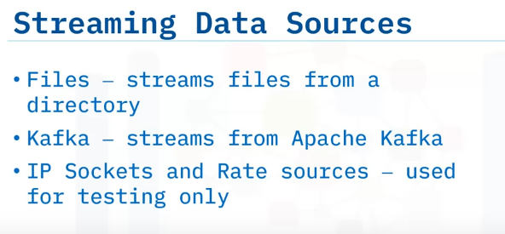
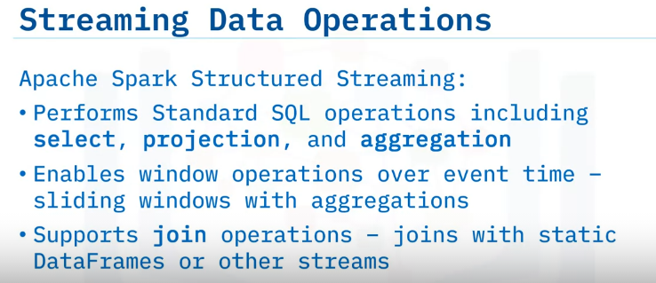
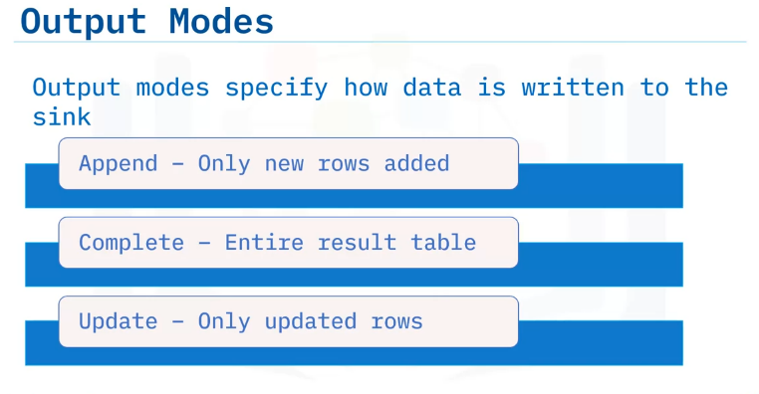
Spark Structured Streaming allows for many different data sources, including files, Kafka, IP sockets and rate sources and others.
Spark Structured Streaming runs on top of the Spark SQL engine that supports standard SQL operations, including select, projection, and aggregation and sliding windows over event time that support aggregations within each window.
You can even join your streams with persistent data on DataFrames or other streams.
While writing data, you can specify to: append the data and only add new rows of data.
Complete the data, which deletes the existing targeted data and starts the output from the beginning, or update existing rows.
These output modes are helpful when implementing specific requirements.
The update output mode is especially helpful to enable and manage late-arriving data points.

Slide 5
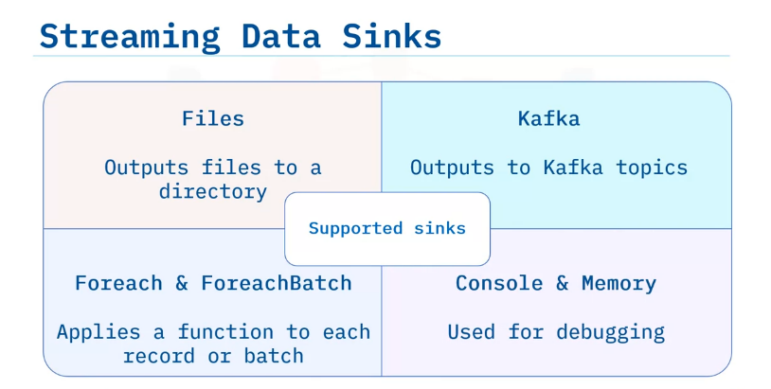
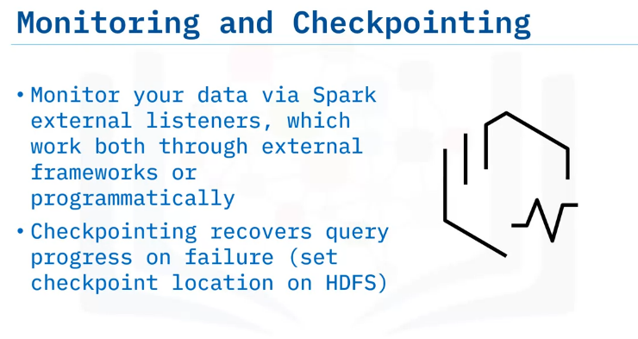
In addition to the already specified data sources like file, which outputs files to a directory, or Kafka, which outputs to Kafka topics.
Structured Streaming supports useful sinks including foreach and foreachBatch, which apply a function to each record or batch.
Console and memory : Note that the console and memory data sinks are recommended for debugging only as these data sinks are not fault-tolerant.
Spark streaming supports advanced features such as external listeners.
External listeners working both through external frameworks or programmatically act as monitors on data streams to trigger events.
To compensate for node failures checkpointing recovers query progress on failure and enables writing streams to disk

Slide 6
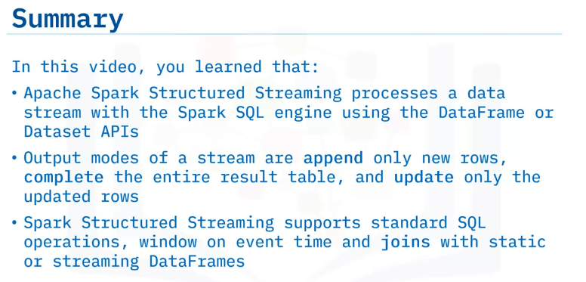

Slide 7
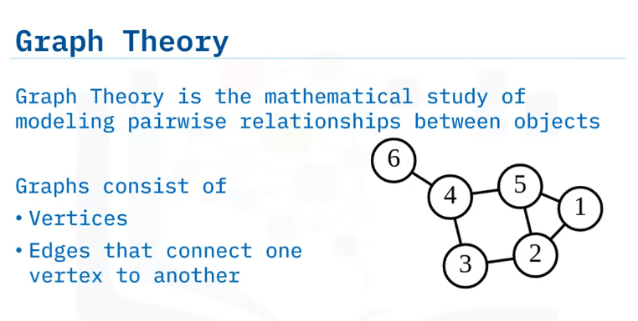
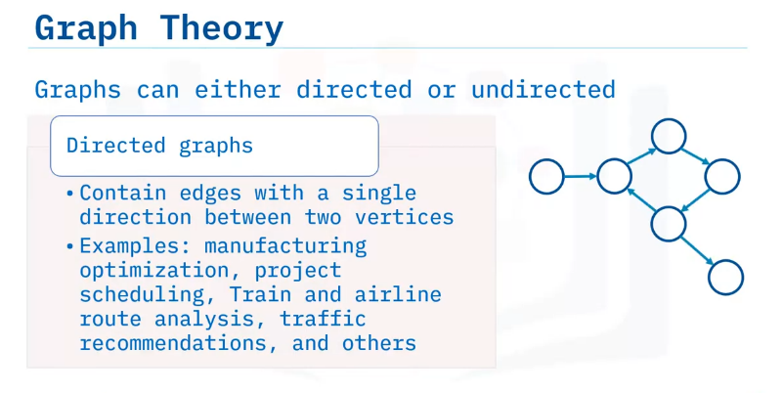
GraphFrames on Apache Spark
Define graph theory. Define GraphFrames.
Explore data suitable for use with GraphFrames.
Graph theory is the mathematical study of modeling relationships between objects.
The graph is a construct that contains a set of vertices with pairwise edges that connect one vertex to another.
Graphs can be directed or undirected.
A directed graph contains edges with a single direction between two vertices, indicating a one-way relationship, illustrated here by the use of the lines with arrows.
Examples include manufacturing optimization, project scheduling, train and airline route analysis, traffic recommendations, and others

Slide 8
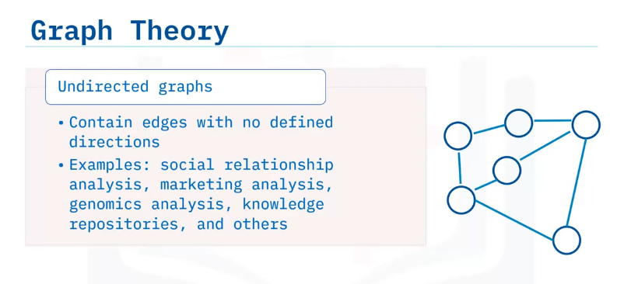
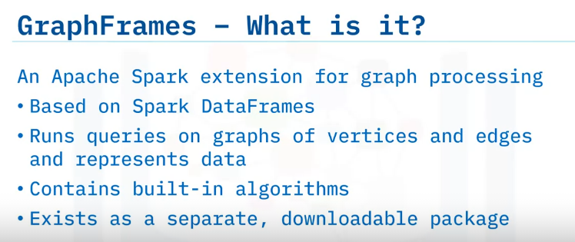
Undirected graphs have edges that represent a relationship without a direction, illustrated here by the use of the lines without arrows.
Examples include social relationship analysis, marketing analysis, genomics analysis, knowledge repositories, and others
GraphFrames is an extension to Apache Spark that enables Spark to perform graph processing, run computations, and analyze standard graphs.
GraphFrames, based on Spark DataFrames, uses the same APIs and represents data as a DataFrame.
The use of DataFrames is the main difference between GraphFrames and GraphX, which is based on RDDs.
GraphFrames contain standard graph-based algorithms capable of covering most use cases.
GraphFrames is not currently included in the Spark installation and must be downloaded as a separate package.
GraphFrame – uses DataFrames
GraphX – uses RDD

Slide 9
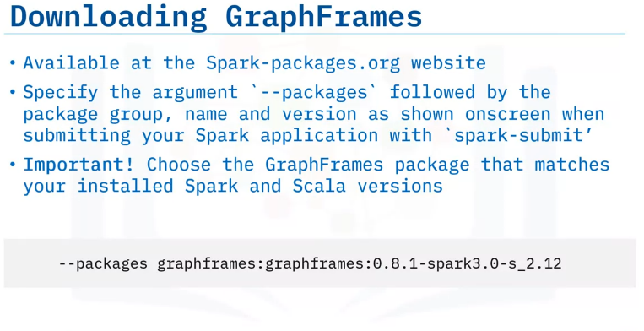
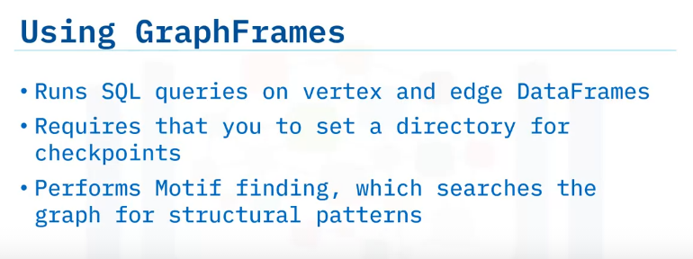
You can download and use GraphFrames with Spark automatically using the package framework.
Use the Spark-packages.org website to locate the correct available versions; otherwise, the package might be unusable.
When submitting your Spark application with ”spark-submit, “include the argument “--packages,” followed by the package group, name, and version as shown in the onscreen example.
Remember to select the correct identifiers for your version of Spark.
This onscreen example will download and use GraphFrames version 0.8.1 for Spark 3.0 with Scala version 2.12.
Because GraphFrames is based on Spark SQL, you can use the same APIs to run SQL queries directly on the provided vertex and edge DataFrames.
GraphFrames requires that you set a directory for checkpoints.
GraphFrames supports Motif finding.
Motif finding is the search for structural patterns or a sub-graph that repeats itself.
GraphFrames supports Motif finding with the `find()` method that used domain-specific language (DSL) to specify the search query in terms of edges and vertices.

Slide 10
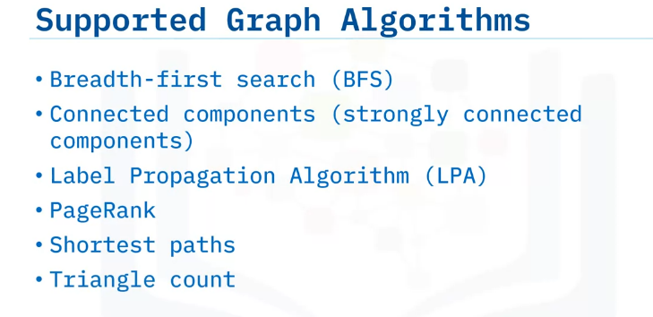
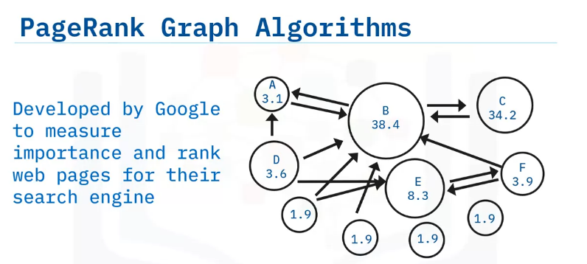
GraphFrames currently supports the following widely used algorithms
Breadth-first search
Connected components
Label Propagation Algorithm
PageRank
Shortest paths
Triangle count
A notable everyday use of an algorithm is PageRank.
As reported by Wikipedia, PageRank, originally developed by Google, is the algorithm used to measure importance, and rank web pages for their search engine.
If you’re interested in how Google currently returns search results, the Google search blog pages provide algorithm descriptions in non-technical but interesting detail.

Slide 11
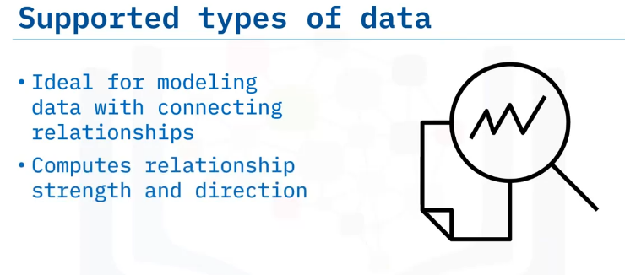
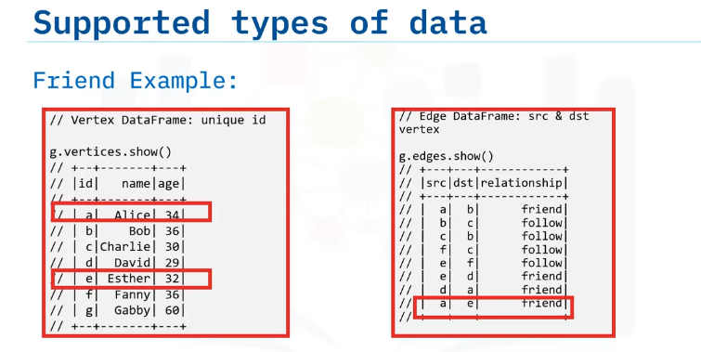
Generally speaking, the type of data suited for GraphFrames is any data that can be modeled with connecting relationships.
You can use GraphFrames to compute the strength and direction of the relationship.
In this example, a graph where people are vertices, and the relationship between people is represented by an edge with a property indicating if they are friends with a person or follow another person on a social media site.
In this example, we can see that Alice and Esther are friends.
GraphFrames produces two DataFrames from this data, one DataFrame for the vertices that list the people and one DataFrame for the edges that display the relationships among the people.
You can query these DataFrames individually with Spark SQL or use any of the GraphFrames provided algorithms.

Slide 12
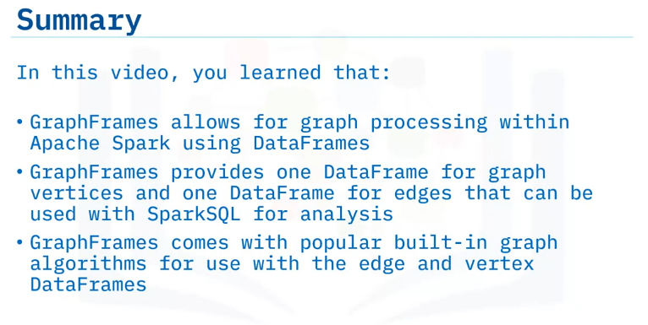

Slide 13
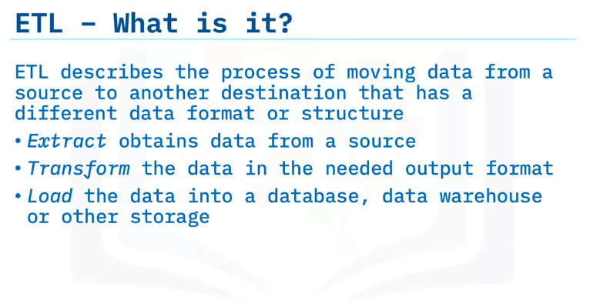
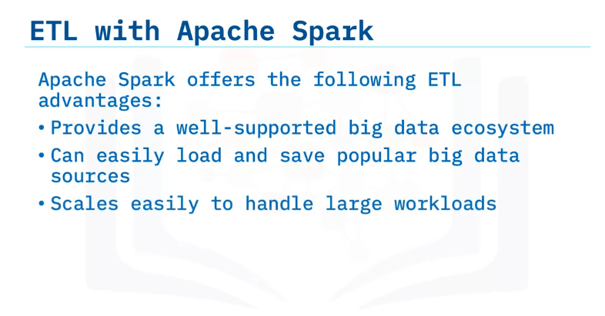
Define ETL - Extract, Transform and Load
Describe how to extract, transform and load data using Apache Spark
ETL Workloads
Extract, Transform, Load, abbreviated as ETL, is a common big data paradigm.
ETL describes the process of moving data from a source to another destination that has a different data format or structure.
The Extract step obtains the data from a source and reads the data into an application. During the Transform step, you clean the data and change the data into a suitable format for the destination.
The final Load step takes the transformed data and loads the data into a data warehouse, database, or other data sink for further transformation and analysis as needed.
Apache Spark directly integrates the standard big data ecosystem with support for native HDFS and file formats like Parquet and other data sources.
Another Spark benefit is that you can easily clean and transform the data after extraction using the Spark SQL framework.
And, Spark scales to handle small to large ETL workloads with ease so that you can use the same application as the data sizes increase.

Slide 14
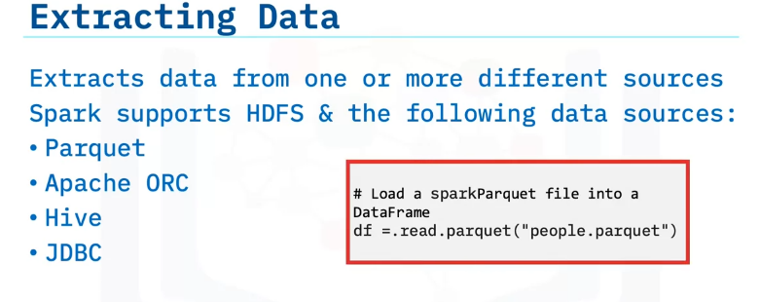
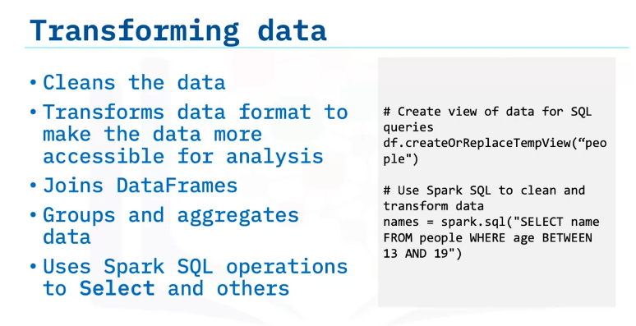
Spark supports HDFS data extraction from Parquet, Apache ORC, Hive, and JDBC.
During the Extract step, data can originate from more than one data source, such as a Parquet data set and a Hive table.
Along with built-in support for many of the most popular data sources, Spark also has an extendable data source API for extracting data from custom sources.
Here, you can see onscreen how to load a Parquet file named “people” into a DataFrame.
The goal of transformation is to clean the data after extraction making the data more accessible and removing the need for additional cleaning and formatting.
You can join DataFrames and group and aggregate data for later ease of use.
For example, eliminating unneeded columns or trimming whitespace from strings can result in clean data in the required format and ready for loading into a new data sink.
The sample here uses Spark SQL first to create a view of the people data set and then uses the SELECT operation to transform the data to people between ages 13 and 19.

Slide 15
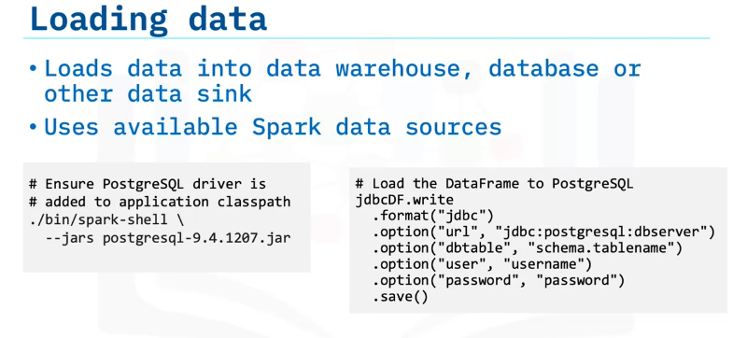
The Load step places your transformed data in its next repository for use, such as a data warehouse, database, or other data sinks. You can use the same Spark data sources for this process as in the Extract step.
For example, the load process could write the transformed DataFrame using a JDBC driver.
In this example, you first add the PostgresSQL driver to the application classpath for use in the cluster.
Next, you write the transformed DataFrame to a database using the supplied PostgreSQL driver and the provided username and password.

Slide 16
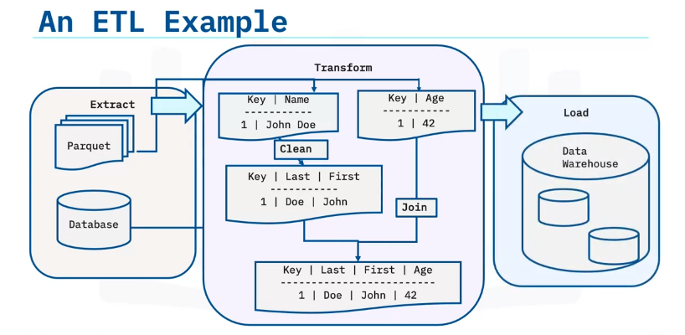
Here is a basic example of an ETL workflow. The first data source extracts a Parquet file to create a DataFrame with a “Name” column.
The next data source extracts other information, such as age, from a database into a second DataFrame.
Data stored in the “Name” column is cleaned and transformed into two columns to separate first and last names.
These two DataFrames are then joined and loaded into the data warehouse for further analysis using the new format.

Slide 17
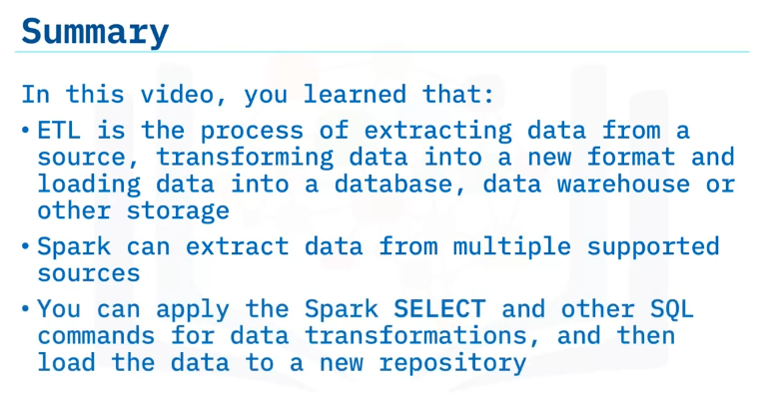

Slide 18
Summary & Highlights
In this module, you learned that:
Streaming data is continuously generated and often originates from more than one source, and unavailable as a complete data set. Data is continuously created; thus, past data is often unavailable because the data volume is too much to store.
Apache Spark Structured Streaming processes data streams using the Spark SQL engine and DataFrame or Dataset APIs.
Output modes of a stream append only new rows, complete the entire result table, and update only the updated rows to Files, Kafka, Foreach & ForeachBatch, and Console and Memory locations.
Spark Structured Streaming supports standard SQL operations, window on event time, and joins with static or streaming DataFrames.
Spark streaming supports external listeners, which work both through external frameworks or programmatically, act as monitors on data streams to trigger events.
Checkpointing compensates for node failures by recovering query progress on failure and enables writing streams to disk.
GraphFrames enables graph processing within Apache Spark using DataFrames. GraphFrames provides one DataFrame for graph vertices and one DataFrame for edges for use with SparkSQL. GraphFrames includes popular built-in graph algorithms for use with both edge and vertex DataFrames.
ETL is the process of extracting data from a source, transforming data into a new format, and loading data into a database, data warehouse, or other storage. Spark can extract data from multiple supported sources. You can apply the SELECT and other SQL commands for data transformations and then load the data to new repositories.

